Slide 1
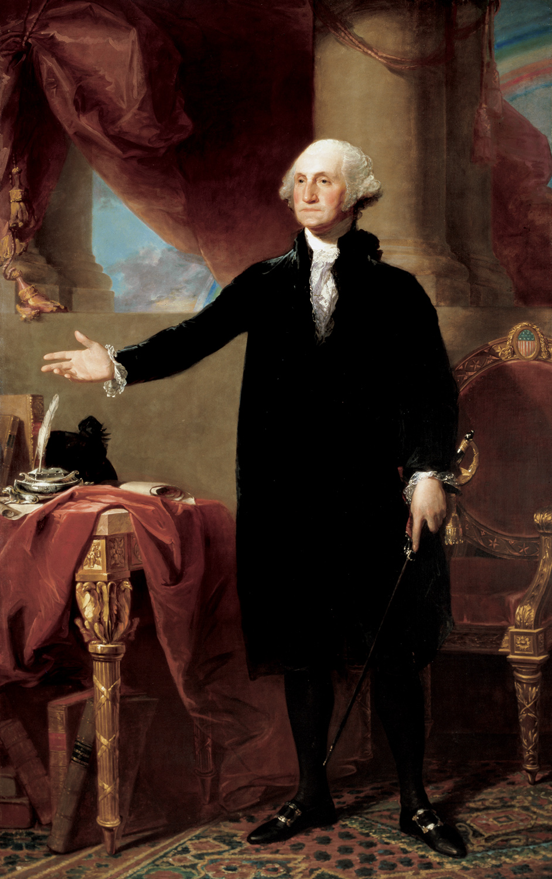
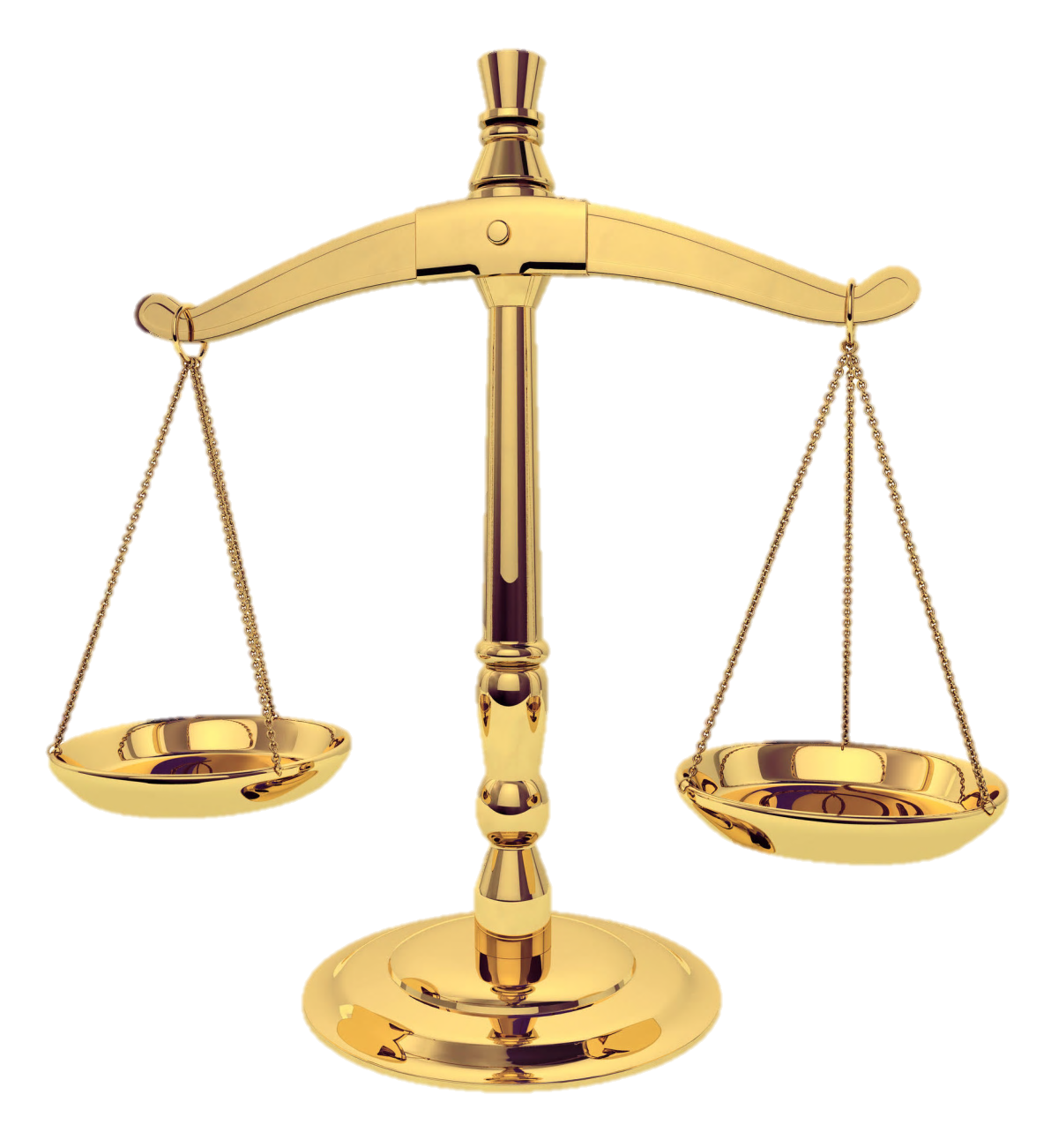
WEIGH
EVIDENCE
THE
Washington

Slide 2
Instructions
- Rate each of the following exhibits based on how well it supports the statement:
“George Washington deserves to be on the one-dollar bill.”
-Each exhibit is rated from -2 (very against the statement) to + 2 (very supportive of the statement)
-A rating of 0 means the source is not useful in either case
-For each write one or two sentences defending your rating.
Notes:
Though few in number, Washington’s critics had good reason to dislike him.
Washington should be on the one dollar bill.
PRO:
Quotes from him
Historian quotes
poll
Con:
Myths
Random Anti-federalist guy
PPT Slide

Slide 3
Set up your paper into columns like this:
Exhibit
Rating
Why?
Z – Photograph
of forest
+1
Stories of bigfoot often say he lives in the forest. This is actually a forest so the stories are somewhat believable.

Slide 4
Not all evidence is equally important. Part of drawing a conclusion is determining how much weight you give to each bit of information.
EVIDENCE
EVIDENCE
-2
Heavily against
-1
Slightly against
0
No
value as a source
+1
Slightly for
+2
Heavily for

Slide 5
Exhibit A:
Slide from Powerpoint by Mrs. Wente

Slide 6
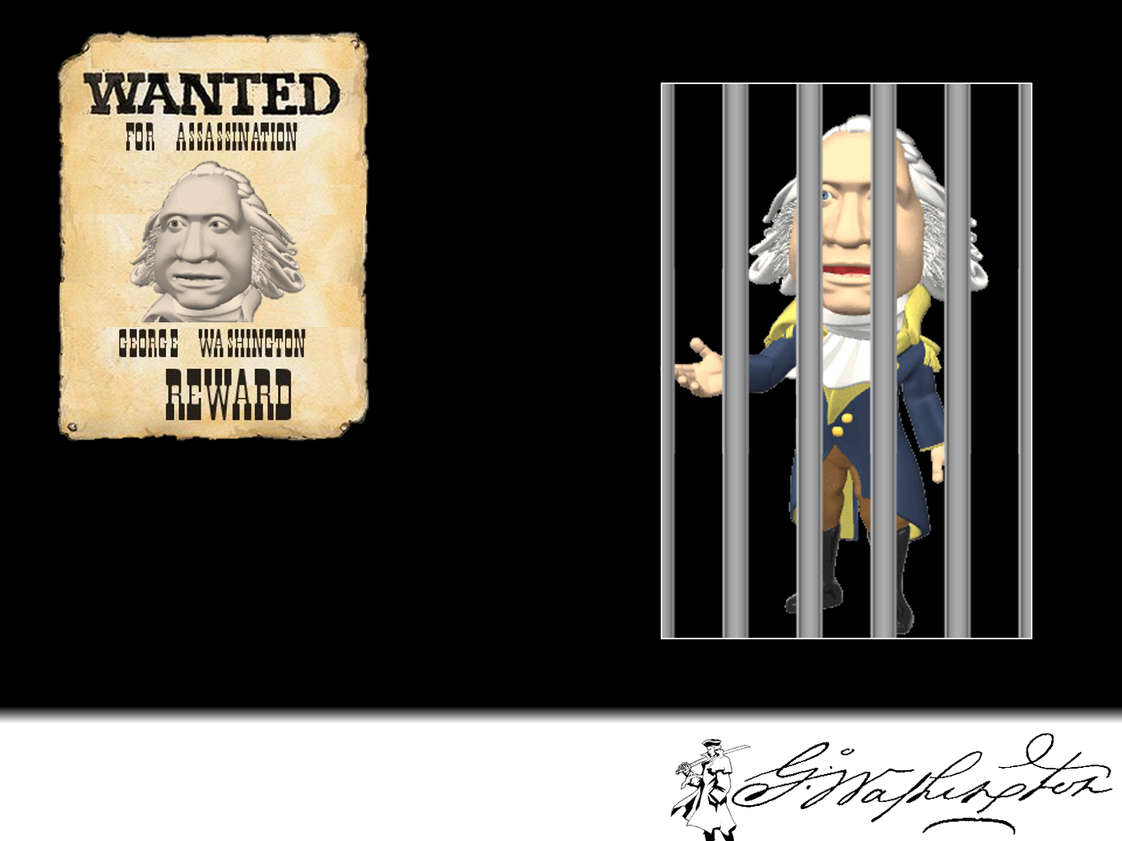
Before the start of the French and Indian War, George Washington had been sent to convince the French to leave their forts on the frontier. After his meeting with the French commanders, one of the Frenchmen ended up dead. The French wanted to arrest Washington for assassination. He escaped back to Virginia, but the war was on.
Washington deserves to be on the one dollar bill.
Notes:
-1

Slide 7
Exhibit B:
Poll of Viewers of Cspan (1999)

Slide 8
C-SPAN poll
In addition to conducting a historian survey, C-Span also conducted a presidential leadership survey of 1145 viewers in December 1999.
Abraham Lincoln
Franklin D. Roosevelt
George Washington
Theodore Roosevelt
Ronald Reagan
Harry S. Truman
Woodrow Wilson
Thomas Jefferson
John F. Kennedy
Dwight D. Eisenhower
Washington deserves to be on the one dollar bill.
Notes:
+

Slide 9
Exhibit c:
Editorial by Benjamin Franklin Bache in 1797
Notes:
-

Slide 10
Benjamin Franklin Bache regarding Washington’s Retirement
“Lord, let thy servant depart in peace for my eyes have seen your salvation,” was said by Simeon after seeing Jesus Christ. If there ever was a time appropriate for it to be said again it is now. For the man who is the source of all the misfortunes of our country is this day to reduced to the same level as his fellow citizens and no longer possesses the power to multiply evils upon the United States.
If ever there was a period for rejoicing, this is the moment. Every heart together with the freedom and happiness of the people should cry out in joy that the name of Washington, from this day, no longer justifies political evil nor legalizes corruption. A new era is upon us – a new era which promises much to the people. For new laws must now stand upon their own merits and not just be supported by a name.
When a retrospect is taken of the Washington administration for eight years, it is a subject of the greatest astonishment that a single individual could have cancelled the principles of republicanism in an enlightened people and could have carried out his plans against liberty so far as to have risked its very existence. Such, however, are the facts, and with these staring us in the face, this day ought to be a day of celebration in the United States.
Aurora, March 6, 1797
Washington deserves to be on the one dollar bill.
Notes:
Paraphrased for readability

Slide 11
Exhibit D:
Washington on Slavery
http://www.digitalhistory.uh.edu/

Slide 12
Washington on Slavery Digital History ID 190
Author: George Washington Date:1786
Annotation:
In this brief note, written at a time when he owned some 277 slaves, George Washington expresses his hopes for the gradual abolition of slavery. This letter not only reveals Washington's principles and distaste for slavery, but also an outlook shared by many of the founders, including many from the upper South. Many of the new nation's leaders desperately wanted to find gradualistic solutions to America's deepest-rooted problem. In his will, Washington provided for the emancipation of his slaves following his wife's death.
Document:
...I never mean (unless some peculiar circumstances should compel me to it) to possess another slave by purchase; it being among my first wishes to see some plan adopted by the Legislature by which slavery in this Country may be abolished by slow, sure & imperceptible degrees.
Source: Gilder Lehrman Institute
Additional information: George Washington to John Francis Mercer
Washington deserves to be on the one dollar bill.
Notes:
+

Slide 13
Exhibit E:
Modern Book
(2006)

Slide 14
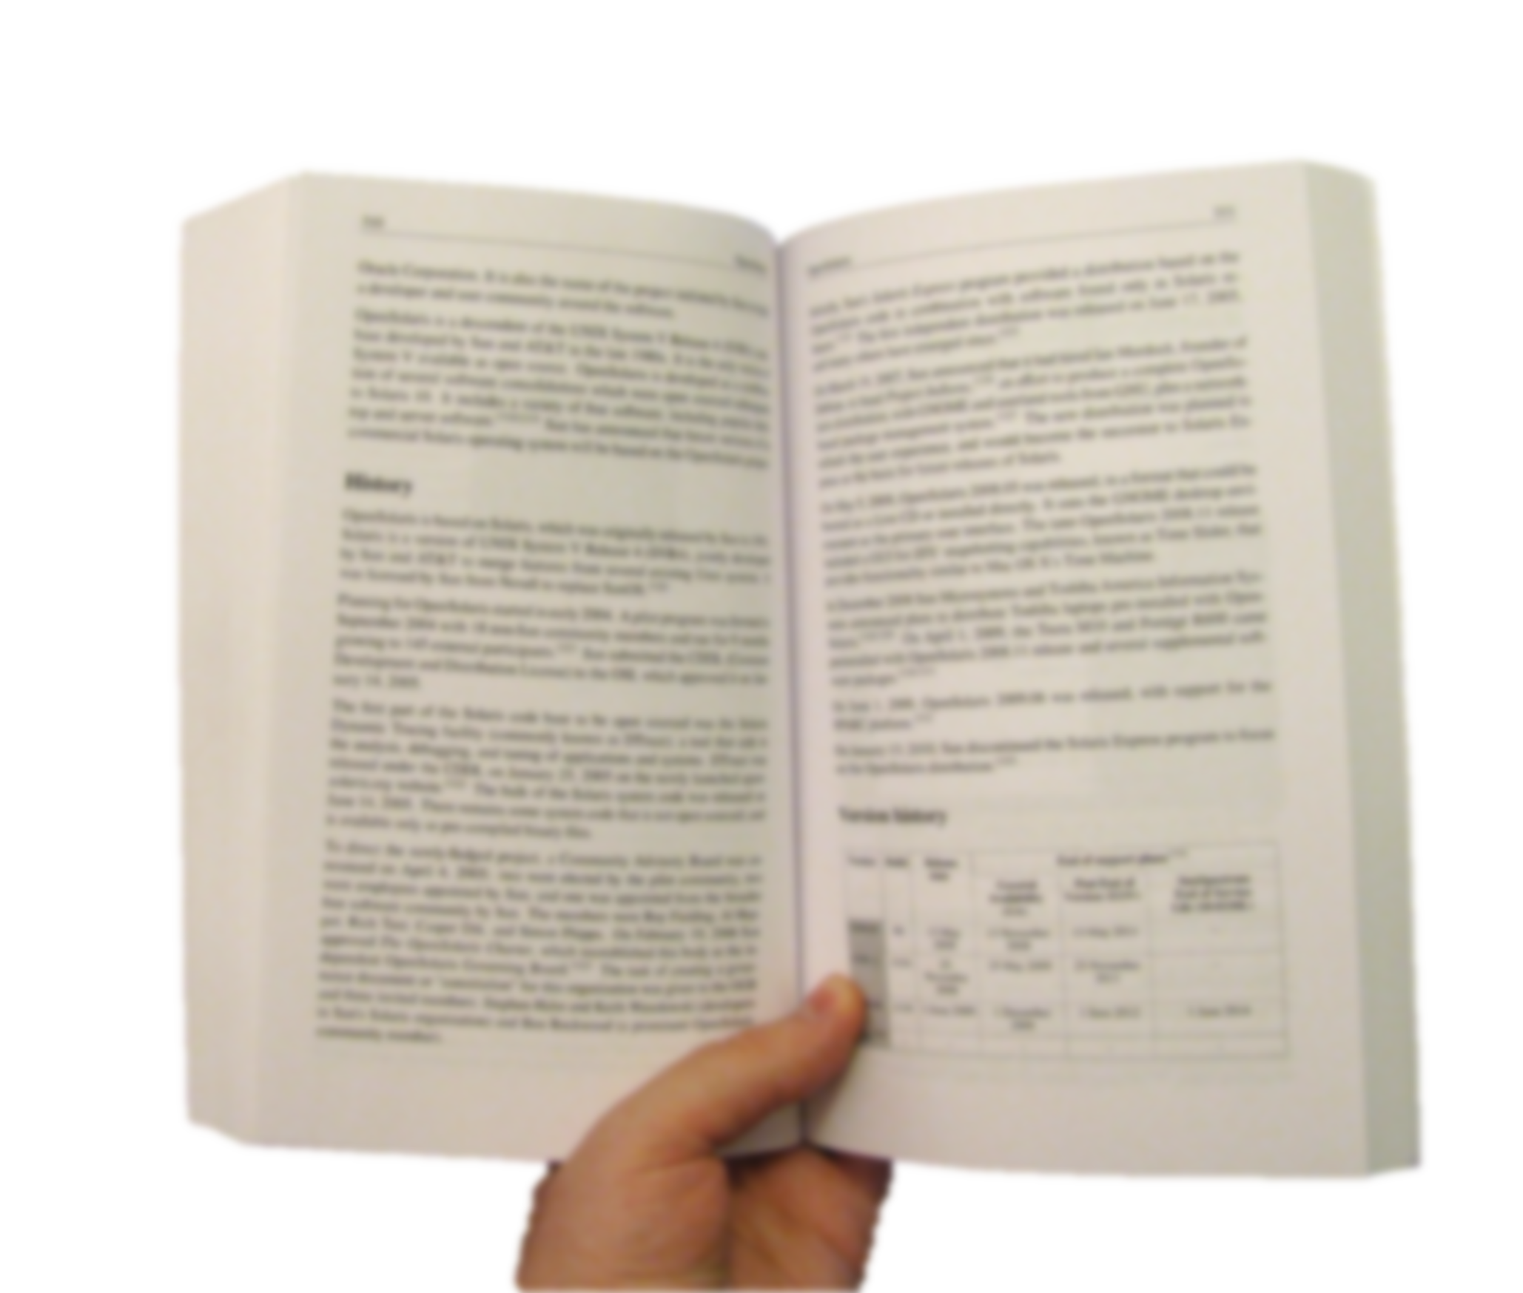
Americans believed in George Washington. They saw him as an honest leader and a hero of the Revolution. Many believed he should be the first U.S. president. Washington had been looking forward to retirement and a quiet life on his Virginia farm. When he hesitated at becoming a candidate for the presidency, his friends convinced him to run. Fellow politician Gouverneur Morris told him, “Should the idea prevail [win] that you would not accept the presidency, it should prove fatal… to the new government.” Morris concluded confidently, “Of all men, you are the best fitted to fill that office.”
Source: Deverell and White, United State History, 2006
Exhibit M:
Modern book
Washington deserves to be on the one dollar bill.
Notes:
Preferably a minus

Slide 15
Exhibit F:
“Washington Crossing the Delaware”
Painting by William Hole c. 1900 A.D.
Notes:
+

Slide 16
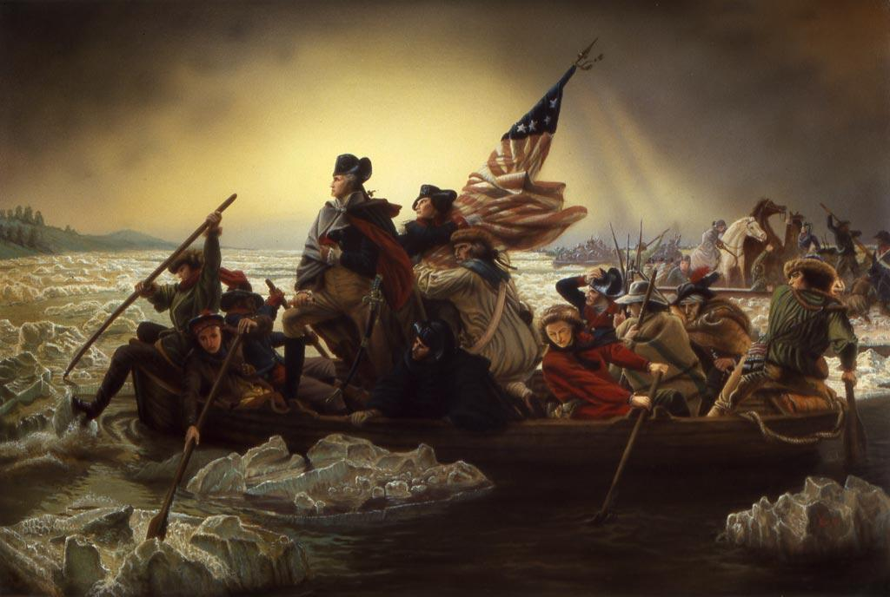
Washington deserves to be on the one dollar bill.

Slide 17
Exhibit G:
Scene from “The Crossing” 2000 A.D.
Notes:
+

Slide 18
Watch from beginning to min 3.20
https://www.youtube.com/watch?v=WqitLNTTUzc
Washington deserves to be on the one dollar bill.

Slide 19
Instructions
Add up all of your rating numbers from the exhibits. If your rating is positive he deserves to be on the dollar. If it is negative he does not.
Write an ARE answering: “Does George Washington deserve to be on the one dollar bill?”
Assertion- Washington does/does not deserve to be on the one dollar bill.
Reason- The evidence shows…
Evidence x 2- This is proven by exhibit ____ which shows _______ and exhibit ___ …

