Slide 1
Visual Study Guide
Age of Exploration & Conquest
Directions:
Use the flashcard slides to practice matching ideas with terms. Some terms have more than one match.
Type answers to the thought bubbles onto the slide. Feel free to add clip art or images that help you remember!

Slide 2
Migrate
Ice Age
Domestication
Large area of land under water today
Moving from Asia to the Americas
The most critical discovery in the history of civilization
Caused Beringia to emerge
Planting food and raising animals
Allowed ancient Americans to walk here
A person who spends all their time looking for food
Hunter-Gatherer
Beringia

Slide 3
Caravel
Muslim
Bartolomeu Dias
Triangle sails
The major religion in Northern Africa
New ship technology
Sailed to southern tip of Africa
Christians saw these people as a threat
Allowed people to sail anywhere they wanted
Failed to complete his goal
Sailed around Africa to Asia
Vasco de Gama
Sailed to the Americas but thought he was in Asia
Columbus

Slide 4
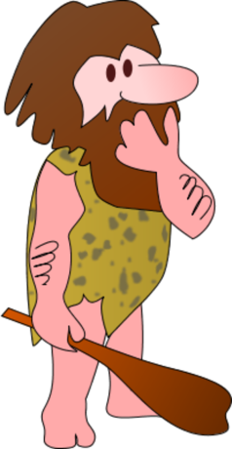
How did the first peoples come to the Americas?

Slide 5
How did domestication lead to civilization?

Slide 6
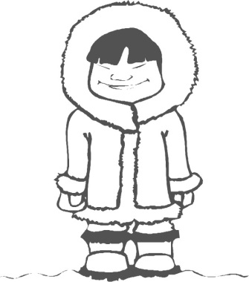
Explain how Eskimos (Aleut or Inuit) are a good example of civilization in America.

Slide 7
How was the Iroquois League unusual for its time in history?

Slide 8
Who fought in the Crusades, and what were they fighting over??

Slide 9
How did the Crusades lead to Europeans being interested in going to Asia?

Slide 10
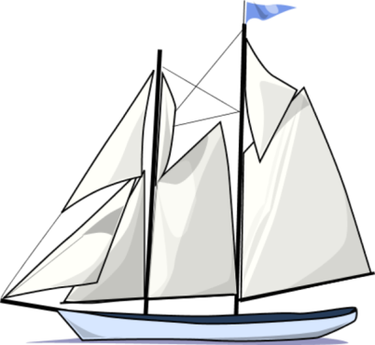
Why didn’t European countries just sail the “easy way” to Asia, through the Mediterranean Sea?

Slide 11
How did Italy become so important in European trade?

Slide 12
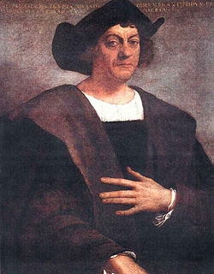
What did Columbus do wrong when planning his journey?

Slide 13
Who sponsored Columbus’ trip? Why did he need a sponsor?

Slide 14
What happened in 1942?

Slide 15
What happened in 1492?

Slide 16
Why was Columbus so frustrated when he died?

