Slide 1
Maps Quiz
Instructions:
1. On your own piece of paper, write your name and class period in the Upper right-hand corner.
2. Number your paper 1-14.
3. Answer each question on your paper.
4. When you get to questions 7, 8, and 9, you can touch-and-drag the answers. Raise your hand when you’re ready for me to grade questions 7, 8, and 9.
5. When you’re finished, turn in your paper into your class’ folder in Mrs. Wente’s metal crate on her desk.
****After you are finished you must have a drawn out picture of your continent that shows how you will be painting it. This requires approval before you’ll be allowed to paint.

Slide 2
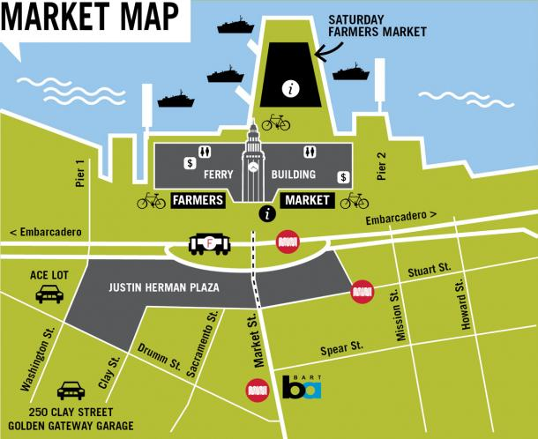
Information Booth
Restrooms
ATM
Bike parking
Car parking
Trolley line
Ferry boat landing
What two map parts are missing from this map (title, scale, legend, compass rose)?
What does represent?

Slide 3
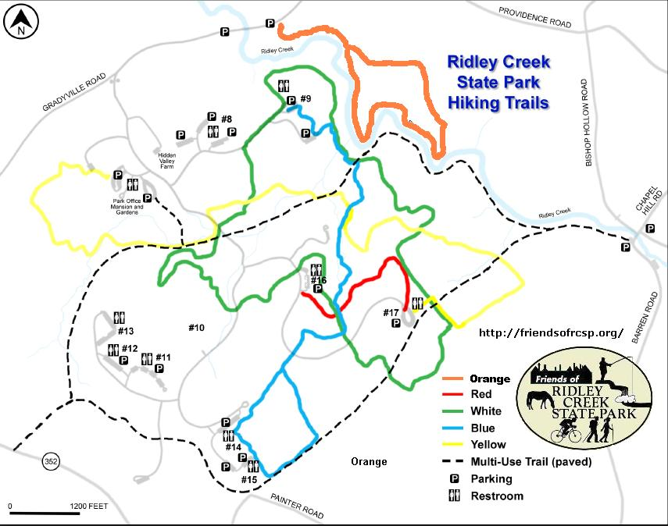
3. What is this map showing you?
Which color trail goes the farthest North?
5. Which color trail goes the farthest West?
6. About how many feet apart is Restroom #11 from Restroom #13?

Slide 4
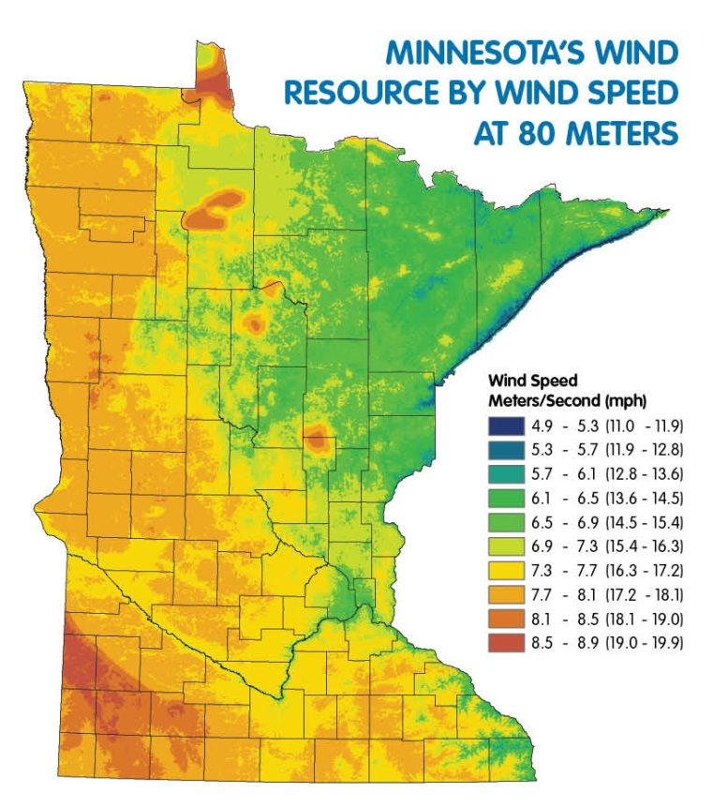
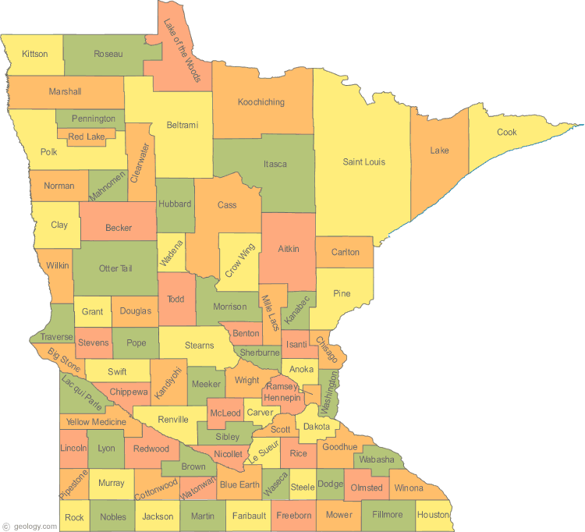
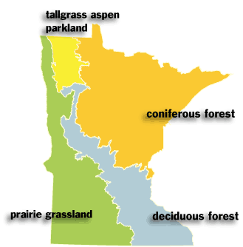
Instructions: On your paper write the word that matches the map.
7.
Political
Informational
Physical
8.
9.

Slide 5
Instructions: Match up each map part with its function.
Compass Rose a. Tells you what the map is about
Scale b. Tells you which way is North
Title c. Tells you what symbols mean
Legend d. Tells you the distance between
places on the map
Re-draw the picture below onto your paper.
Then correctly fill in the 7 missing directions.
N

